Slide 1
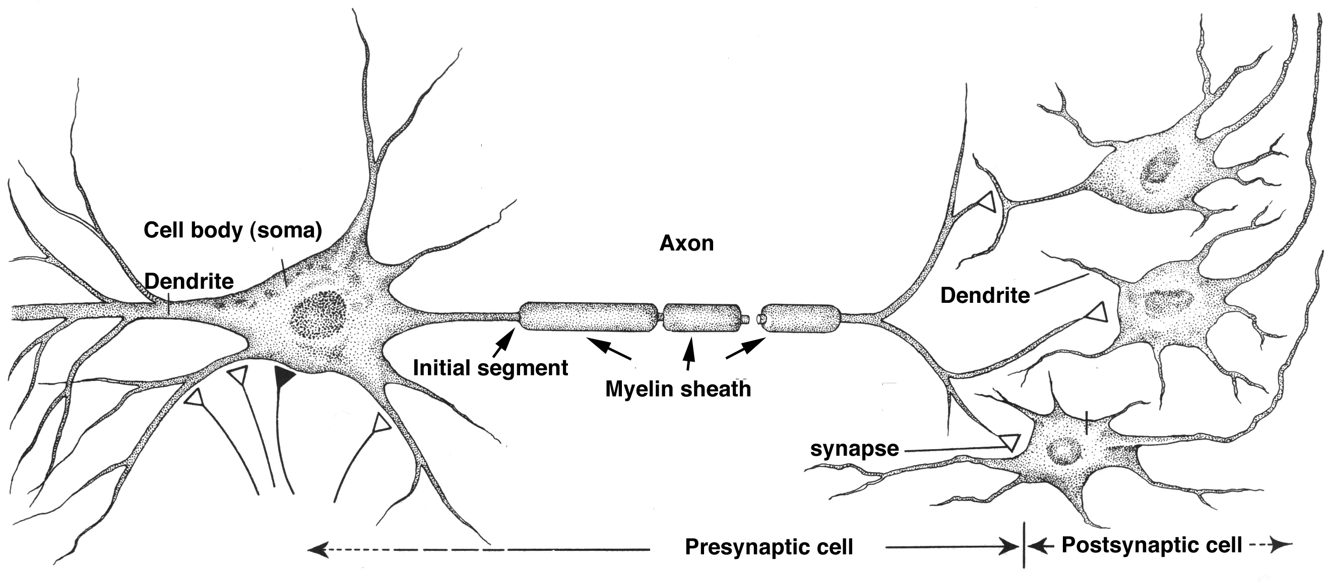
Neurological Disorders Lesson 3.2
How do our neurons communicate with each other?
Electrical Signal
Chemical Signal

Slide 2
Do Now:
Sleeping Beauty just pricked her finger and is feeling a lot of pain. Model the neurons involved in Sleeping Beauty sensing this pain.
In order for one neuron in this pathway to send information to the next, how would you change the electrical signal of the axon into a chemical signal at the synapse ?

Slide 3
Pain Pathway
Sensory neuron
Projection neuron
Motor neuron
Interneuron

Slide 4
Converting an Electrical Signal to Chemical Signal
Electrical Signal
Chemical Signal

Slide 5
Synaptic Transmission
Electrical Signal
Neurotransmitter

Slide 6
Synaptic Transmission
Electrical Signal
Neurotransmitter

Slide 7
The Stage:
Presynaptic cell
Synapse
Postsynaptic Cell

Slide 8
The Characters:
Voltage-gated Ca²⁺ channels
Synaptic vesicles
Neurotransmitters (NT)
Action Potential
Ca²⁺ sensitive proteins
Receptors
Reuptake Transporters

Slide 9
Your most common neurotransmitters
Neurotransmitter | Function
Acetylcholine | Gets us going. It excites cells, activates muscles, and is involved in wakefulness, attentiveness, anger, aggression, and sexuality. Alzheimer’s disease is associated with a shortage of acetylcholine.
Glutamate | Is a major excitatory neurotransmitter. It is dispersed widely throughout the brain. It’s involved in learning and memory.
GABA | Is your brain’s main inhibitory neurotransmitter. It slows everything down and helps keep your system in balance. It helps regulate anxiety.
Epinephrine | Also known as adrenaline, keeps you alert and your blood pressure balanced, and it jumps in when you need energy. It’s produced and released by the adrenal glands in time of stress. Too much can increase anxiety or tension.
Dopamine | Is vital for voluntary movement, attentiveness, motivation and pleasure. It’s a key player in addiction.
Serotonin | Helps regulate body temperature, memory, emotion, sleep, appetite, and mood. Many antidepressants work by regulating serotonin.

Slide 10
How do the characters work together to complete synaptic transmission?
Card Sort Activity

Slide 11
The Play:
1. Action Potential

Slide 12
The Play:
2. Voltage-gated Ca²⁺ channels open.
1. Action Potential

Slide 13
The Play:
2. Voltage-gated Ca²⁺ channels open.
3. Ca²⁺ flows into cell
Ca²⁺
1. Action Potential

Slide 14
The Play:
2. Voltage-gated Ca²⁺ channels open.
4. Ca²⁺ sensitive proteins fuse synaptic vesicles to membrane.
3. Ca²⁺ flows into cell
Ca²⁺
1. Action Potential

Slide 15
The Play:
2. Voltage-gated Ca²⁺ channels open.
4. Ca²⁺ sensitive proteins fuse synaptic vesicles to membrane.
3. Ca²⁺ flows into cell
5. NTs are released into synaptic cleft
Ca²⁺
1. Action Potential

Slide 16
The Play:
2. Voltage-gated Ca²⁺ channels open.
4. Ca²⁺ sensitive proteins fuse synaptic vesicles to membrane.
6. NTs bind to postsynaptic receptors.
3. Ca²⁺ flows into cell
5. NTs are released into synaptic cleft
Ca²⁺
1. Action Potential

Slide 17
The Play:
2. Voltage-gated Ca²⁺ channels open.
4. Ca²⁺ sensitive proteins fuse synaptic vesicles to membrane.
6. NTs bind to postsynaptic receptors.
3. Ca²⁺ flows into cell
5. NTs are released into synaptic cleft
Ca²⁺
1. Action Potential
7. Ion channels open on postsynaptic membrane, allowing ions to flow into cell.

Slide 18
The Play:
2. Voltage-gated Ca²⁺ channels open.
4. Ca²⁺ sensitive proteins fuse synaptic vesicles to membrane.
6. NTs bind to postsynaptic receptors.
3. Ca²⁺ flows into cell
5. NTs are released into synaptic cleft
Ca²⁺
1. Action Potential
8. Excess NTs are degraded by enzymes or pumped back into presynaptic cell.
7. Ion channels open on postsynaptic membrane, allowing ions to flow into cell.

Slide 19
What would happen if…
You took a drug that destroyed the Ca²⁺ sensitive proteins that fuse synaptic vesicles to the membrane???
You wouldn’t be able to release synaptic vesicles.

Slide 20
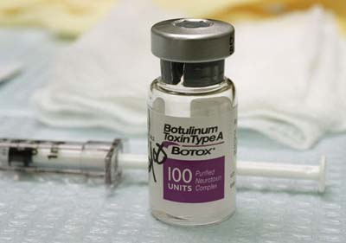
That’s How Botox Works!
Before
After
Botox destroys the proteins that fuse synaptic vesicles with the membrane.
By stopping vesicle release, Botox prevents muscle contraction which prevents wrinkles!

Slide 21
Synaptic Transmission
2. Voltage-gated Ca²⁺ channels open.
Ca²⁺ flows into cell
3. Ca²⁺ sensitive proteins fuse synaptic vesicles to membrane, releasing NTs into synaptic cleft
4. NTs bind to postsynaptic receptors.
Ca²⁺
1. Action Potential
6. Excess NTs are degraded by enzymes or pumped back into presynaptic cell.
5. Ion channels open on postsynaptic membrane, allowing ions to flow into cell.

Slide 22
Does it matter which ions flow into the postsynaptic cell?
Sodium (Na⁺)
Calcium (Ca²⁺)
Chloride (Cl⁻)
Positive
Positive
Negative

